Slide 1
DataStax … a technical overview
© 2018 DataStax, All Rights Reserved. DataStax is a registered trademark of DataStax, Inc. and its subsidiaries in the United States and/or other countries. Apache Cassandra, Apache, Spark, and Cassandra are trademarks of the Apache Software Foundation or its subsidiaries in Canada, the United States and/or other countries.

Slide 2
Agenda
Introductions
DataStax, Inc.
Why Cassandra?
Why DataStax Enterprise?
Use cases
Learning resources
Discussion and next steps

Slide 3
DataStax, Inc.
Notes:
Before we jump into the technology, I’d like to take a very brief moment to introduce DataStax.

Slide 4
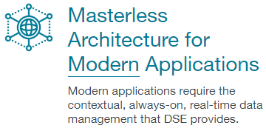
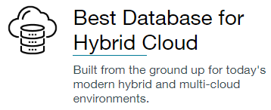
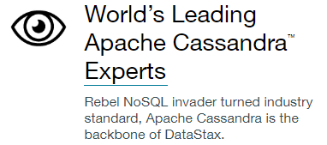
DataStax: Our Mission
Notes:
<CLICK> Our overarching goal at DataStax is to provide the data layer for modern enterprise needs. We believe that this data layer must be Contextual, Always-On, Real-Time, Distributed, and Scalable. Over the next few minutes, I’ll be talking about what these terms mean, and why we think they are essential.
<CLICK> The majority of our customers are already using the cloud for mission-critical applications, and we aim to be the data layer of choice for cloud, multi-cloud, and hybrid cloud environments.
<CLICK> As you know, Apache Cassandra is at the core of everything we do. We are the world’s leading Cassandra experts, providing over 90% of commits to the project. Apache and its community are central to our mission.

Slide 5
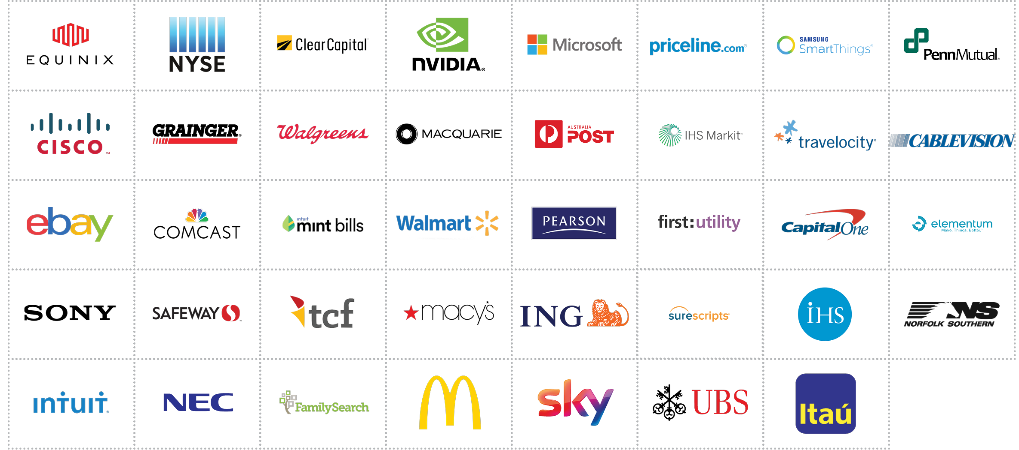




The Most Innovative Companies Use DataStax
Notes:
Today is a day for technology, not for marketing or sales. However, I do think it is important to note that we are much more than a science project. We have over 600 customers, and as you can see here, we are running in some of the largest and most demanding IT environments in the world.

Slide 6
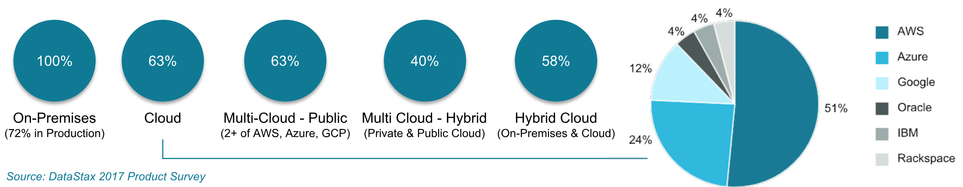
Our Customers Use DataStax For Cloud
63% of DataStax customers have applications running on clouds. Almost 2/3 are deploying applications on multi-cloud, hybrid cloud infrastructure environments, or a combination thereof.
Notes:
And to be sure, we are a cloud solution. Almost two-thirds of our customers are running in clouds today, and that number continues to grow.

Slide 7
Our Customers Use DataStax For Cloud
Multi
^
63% of DataStax customers have applications running on clouds. Almost 2/3 are deploying applications on multi-cloud, hybrid cloud infrastructure environments, or a combination thereof.
Notes:
It’s especially important to note that our customers are running in MULTIPLE public clouds.
<CLICK> That means they are using at least two of the big three vendors: AWS, Azure, and Google.
<CLICK> In fact, of our customers running in cloud…
<CLICK> Every Single One is running in multiple clouds. That just makes sense in this early era of the cloud market. Business managers want to test the waters, and generally aren’t ready to commit to a single vendor. The cloud vendors now have that clear task before them… to prove which of them is the best business partner. I think the fact that we have a representative from <INSERT CLOUD VENDOR NAME HERE> with us today speaks volumes on that topic, and we’re grateful you are here. But the current state of cloud adoption is clear. Right now, Business Managers want products that support multi-cloud operations. As you’ll see for yourselves today, DataStax Enterprise OpsCenter lets you manage a database cluster across multiple clouds, as well as hybrid on-premise and cloud deployments.

Slide 8

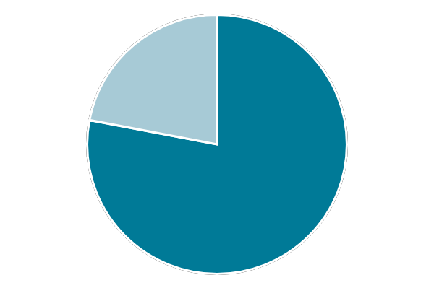
Technology innovation makes PlayStation Sony’s biggest moneymaker.
PlayStation 4 has never been more important to Sony:
60 million+ total monthly active PlayStation users.
200k read/writes per second.
All libraries, recommendations, catalogues, and notifications run on DataStax.
“PS4's Powerful System Architecture, Social Integration and Intelligent Personalization, Combined with PlayStation Network with Cloud Technology, Delivers Breakthrough Gaming Experiences and Completely New Ways to Play.”
22%
Other BUs
78%
PS4 Profit
Sony PS4
Notes:
Multiple PS4 features: Libraries, recommendations, catalogue, notifications, run on DataStax
More than 200k read/writes per second
Hosted in cloud as well as private datacenters
A new web application to manage family accounts, and access parental controls/family membership options from your PC and smartphone. New family accounts will be able to feature multiple adult accounts in a family, able to act in a parent/guardian role and set parental controls on a per-account basis, so each child has different communications, content-viewing and spending limit privileges. allow users to follow anyone they want over the PlayStation Network, although there will be privacy options to block users and make it so only certain people can follow you. Sony is enjoying being the number one console this generation, selling about twice as many PS4 models as Microsoft is selling XBOX models. The consumer electronics giant announced that it has sold over 60.4 million units of the console till June 13, 2017. PS4 Pro, the upgraded version of PS4 gaming console and virtual reality (VR) systems are raking in huge profits.
Sony PlayStation enhances social spectating by enabling gamers to broadcast their gameplay in real-time to friends using live internet streaming services. During live broadcasts, friends can make comments on the streamed gameplay and, if a gamer gets stuck on a challenging level, friends can also join the game in completely new ways. Players can look over game-related information shared by friends, view friends’ gameplay with ease, or obtain information of recommended content, including games, TV shows and movies. PS4 will further enrich users' entertainment experiences, by meeting their potential needs. The "PlayStation®App" enables iPhone, iPad, and Android™ based smartphones and tablets to become second screens. Once installed on these devices, users can, for example, see maps on their second screens when playing an adventure game, purchase PS4 games while away from home and download it directly to the console at home, or remotely watch other gamers playing on their devices. https://www.playstation.com/en-us/corporate/press-releases/2013/sony-computer-entertainment-inc-introduces-playstation-4-ps4/
Broadcast gameplay in real-time to friends using live internet streaming services
Access game-related information shared by friends, view friends’ gameplay with ease, or obtain information of recommended content, including games, TV shows and movies.
Manage family accounts, and access parental controls/family membership options from your PC and smartphone
The PlayStation App allows smartphones and tablets to become second screens.
The PlayStation division is Sony's biggest moneymaker.

Slide 9
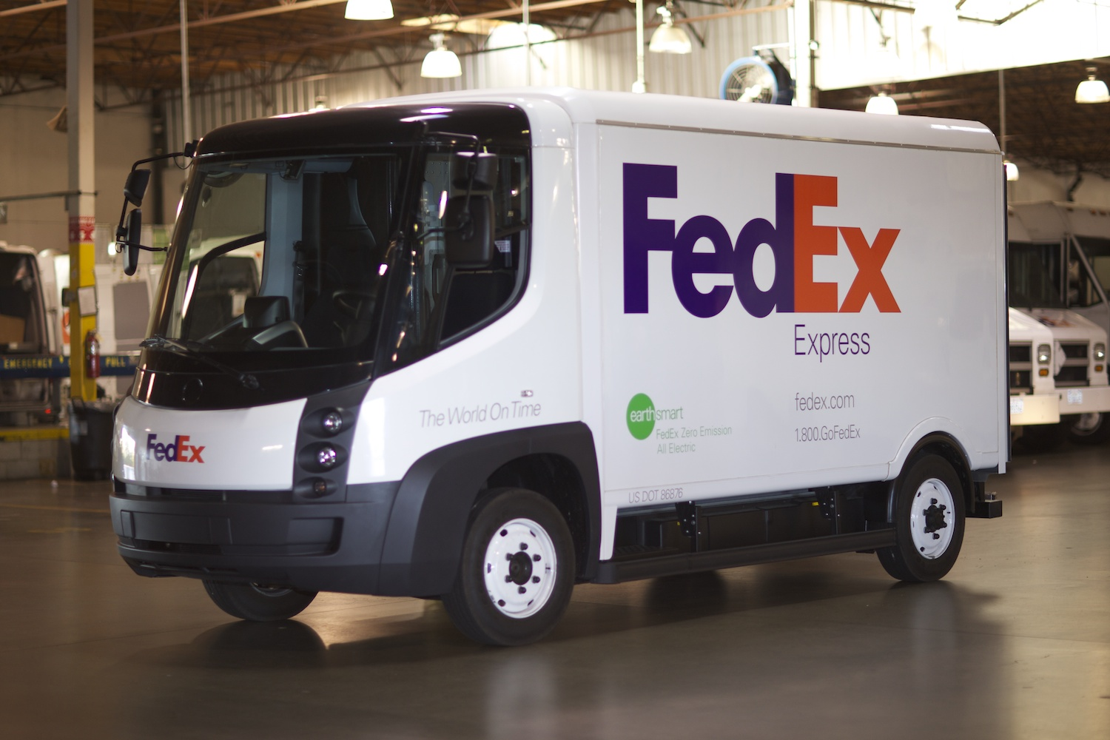
Aiming for fast, seamless service with 20,000 data points per package.
Siri, prepare a shipment.
As per Rob Carter CIO - customers will be able to initiate a FedEx shipment by talking to Apple HomePod, Amazon Echo or Google Home and receive deliveries via autonomous trucks.
Application response time improved by >100%
Global data replication from ~25 mins to milliseconds
100% application uptime saves thousands of dollars per minute
FedEx
Notes:
Providing a fast, seamless service to its customers by reducing application response time to 110 ms (from 250 ms with Oracle) and replication latency to 520 ms (from ~25 minutes with Oracle).
Rob Carter, FedEx’s chief information officer, says customer experience for ordering will be by talking to Alexa or Siri and receiving deliveries via autonomous trucks.

Slide 10
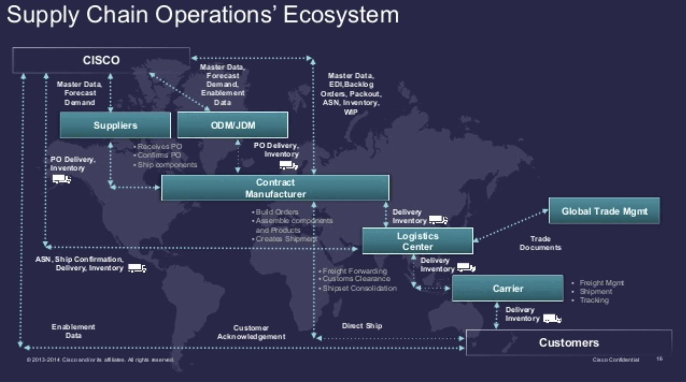
Supply chain optimization delivers profitability and scale.
The Cisco supply chain is highly diverse and global.
Saving US$24m in material costs through automation of its interactions with its partners and suppliers.
Processing ~100,000 orders per quarter while achieving a 45% reduction in inventory.
More than 300 product families
1000+ suppliers and 15000+ users
Millions of annual shipments
Cisco
Notes:
https://www.cisco.com/c/en/us/solutions/collateral/enterprise/cisco-on-cisco/cs-boit-05272014-supply-chain.html (do not use)
Stress high data volume (millions of shipments annually),
Stress distributed user base (15,000 users)
Stress high volatility (100K orders per quarter)

Slide 11

Processes 250M events per day for a real-time view.
USPS is the single largest logistic entity in the US.
Powering geo-spatial, real time view of USPS’s entire fleet and mail assets to enrich customer experience and deliver millions of dollars in savings.
Enables USPS to inform commercial mail clients exactly when their content is delivered and align personalized advertising campaigns around it
Delivers over 500 million mailpieces each day
200,000+ vehicles on road each day
USPS
Notes:
Processes 250 million events per day
By tracking fleet movements in real time, DataStax provides the USPS with immediate visibility into the status of deliveries anywhere in the country, along with information on how each route is progressing, how many drivers are on the road, how many deliveries each driver is making, where their last stop was, and more.
With DataStax, USPS is expected to save millions of dollars in the years to come, achieve more accurate tracking capabilities, ensure on-time deliveries, and increase operational efficiencies.

Slide 12


With 500 million components: converting data to value.
IHS Markit can keep the Parts Content Factory humming, while its customers can find the parts—and the insights—they need.
IHS Markit provides insight and services to Fortune 500 enterprises across business lines that include aerospace, automotive, energy, and technology.
Delivering the true power of The New Intelligence to 50,000 customers in over 140 countries, 94 of the 100 largest U.S. corporations.
DataStax provides the flexibility, high performance, and scalability that the company needed.
IHS Markit

Slide 13
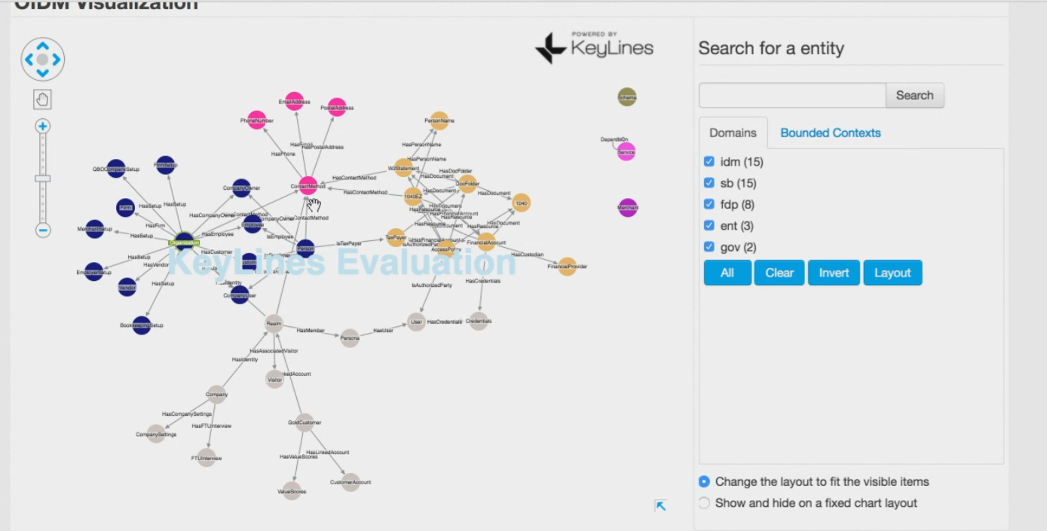
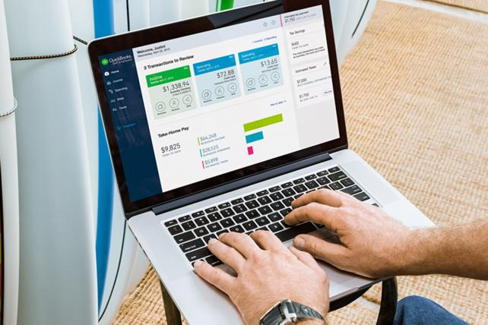
Servicing 42 million customers with the One Intuit ecosystem.
Applying data from many to help one to grow their customers’ collective power.
More customers means more data, and more data means more insights.
Providing a better, more holistic credit score for small business and provide insights on pricing, payroll, payments, and inventory strategies for small business owners that previously only big corporations could access.
With more than 1,545 apps on the platform to help customer meet the unique needs of business.
Business and Customer 360 with the Intuit Data Fabric powered by DataStax.
Intuit
Notes:
https://www.intuit.com/company/press-room/press-releases/2017/intuit-showcases-how-technology-innovation-powers-prosperity-for-consumers-small-businesses/
https://quickbooks.intuit.com/blog/thought-leadership/more-power-2-you-quickbooks-online-surpasses-2-million-global-customer-milestone/
https://docs.google.com/document/d/1Vbk_yChMM5Xnkd55k1U9Th-vbJFG0udOlWd3g9myaQ8/edit
<CLICK> for screen shot of Graph Schema.

Slide 14
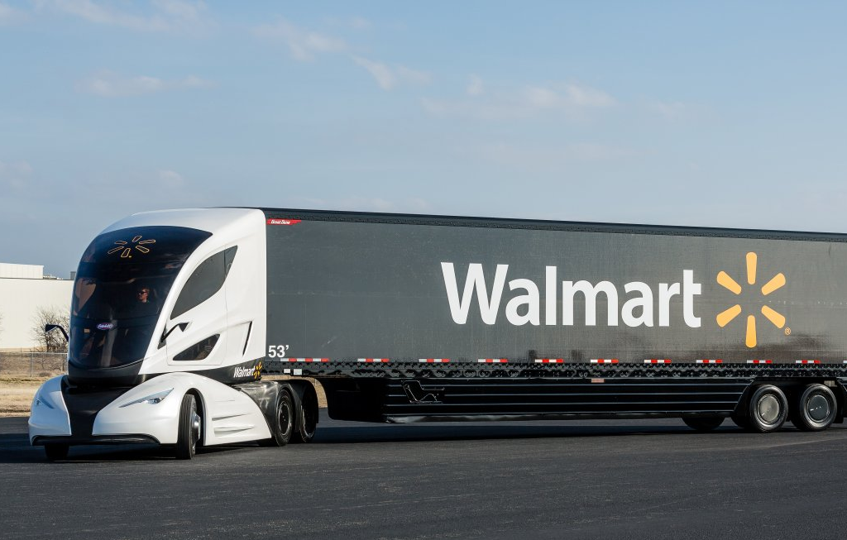
Founded in 1962, on the cutting edge of transforming retail operations and customer experience.
Use sensors placed inside refrigerated trucks to monitor temperature. If the level climbs above a certain degree, drivers could be notified before the food spoils.
Walmart
Notes:
https://drive.google.com/drive/u/0/search?q=Walmart
Corporate initiative for a better customerexperienceWalmart has always worked above and beyond to save money for itspresent and future customers.Increase performance of the eCommerce websiteWalmart has started the initiative to build platforms to offer seamlessshopping experience for store, online and mobile customers.

Slide 15
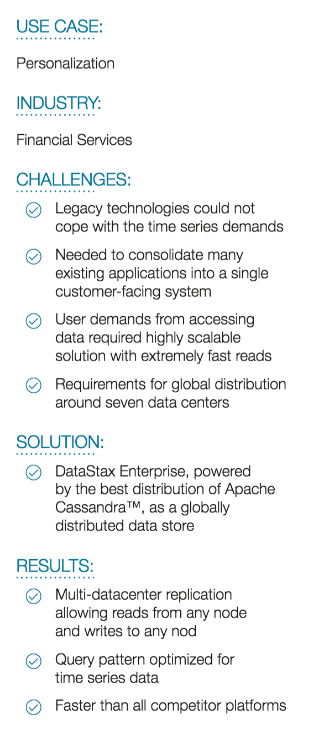

UBS Neo: The first truly cross-asset
investment banking platform.
Just one easy, intuitive way to get the most out of customer relationships with UBS.
The global knowledge-sharing benefits of social networking.
The breadth of UBS Investment Bank’s thought leadership worldwide.
The functionality of market-leading trading technology.
Proving customers access to real-time market intelligence, and UBS Investment Bank thought leaders—across asset classes and around the globe—to form, strengthen and refine your investment ideas.
UBS
Notes:
https://docs.google.com/document/d/1gTi66YVU17wB2_6KI8R1I86mcCVWJXUI6ldcXADg8tY/edit?ts=59b6cd6b
<CLICK> to show executive summary

Slide 16
Customers access data in real time, trading ~3.6 b shares daily.
The main goal of the Intercontinental Exchange is to provide financial data to traders, investors, and academics.
Making sure customers have the information they need to manage their own risks and providing a trusted environment and network secure enough for customers to do their required work.
Ticks (a tick is a price change on a quote) are stored in DataStax and customers can query and see that information in real time.
“DataStax—for us it really helps us scale our environments as we grow beyond the capabilities of single, or even a cluster of computers and we need to be able to scale infinitely.“
The Intercontinental Exchange (NYSE)
Notes:
https://www.forbes.com/sites/blakemorgan/2017/08/15/the-term-ai-is-overused-a-conversation-with-a-chief-data-officer-at-the-intercontinental-exchange/#7f5b1bfd1313

Slide 17
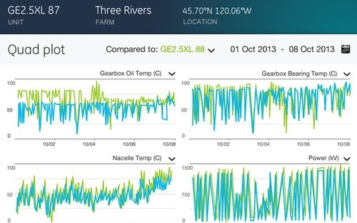

The Power of IoT Data Delivers Profitability.
Delivering $6 billion in revenue in 2016— 20% higher than in 2015, and putting GE on track to hit its goal of $15 billion in annual revenue by 2020.
Predix manages trillions of transactions per day.
DataStax was the only solution that could support this scale.
Collecting sensor data from devices around the world and offering this data back to their clients and customers for predictive maintenance and increased operational efficiencies.
GE Predix
Notes:
GE is offering the first Industrial Cloud Platform called Predix. Datastax is part of the data services layer within the platform where DSE will collect sensor data from a myriad of devices from around the world and then offer this data back to their clients and customers in a way to provide predictive maintenance and increase operational efficiencies.
Our ability to support such a global application rollout was top of mind for the Predix executives. We also delivered additional features, which they plan to leverage, such as Spark Streaming and Solr Search. Our Advanced Replication is also being a considered for their On-Premise Predix offering and Graph is the number #1 project for 2016.
Predix is looking at trillions of transactions per day and we were recognized as the only solution that could offer that scale along with data center replication. The challenge for Predix is data volume, velocity and variety. Connecting the world’s sensors to the Predix platform will deliver a data load, possibly, unseen in current times.
https://www.slideshare.net/RyanZhang7/digital-strategy-to-transform-ge-into-digital-industrial-leader?qid=50e4801d-7d96-41ca-904b-7819650bb7ca&v=&b=&from_search=5
https://www.slideshare.net/JuanPabloGenovese/ge-predix-the-iiot-platform

Slide 18
Servicing 42 Million Customers with the One Intuit Ecosystem
Applying data from many to help one to grow their customers’ collective power.
More customers means more data, and more data means more insights.
Providing a better, more holistic credit score for a small business and provide insights on pricing, payroll, payments and inventory strategies for small business owners that previously only big corporations could access.
With more than 1,545 apps on the platform to help customer meet the unique needs of business.
Business and Customer 360 with the Intuit Data Fabric powered by DataStax
Intuit
Notes:
https://www.intuit.com/company/press-room/press-releases/2017/intuit-showcases-how-technology-innovation-powers-prosperity-for-consumers-small-businesses/
https://quickbooks.intuit.com/blog/thought-leadership/more-power-2-you-quickbooks-online-surpasses-2-million-global-customer-milestone/
https://docs.google.com/document/d/1Vbk_yChMM5Xnkd55k1U9Th-vbJFG0udOlWd3g9myaQ8/edit

Slide 19

Improving member satisfaction and reducing churn.
Why DataStax?
DataStax Enterprise with graph technology for comprehensive Member Journey visibility
Can help in retaining 112K + additional members (3% pt. churn reduction)
Driving an estimated $16.2M incremental operating income and 50% duplicate call volume reduction over the next 5 years.
Kaiser
Notes:
https://docs.google.com/document/d/1gTi66YVU17wB2_6KI8R1I86mcCVWJXUI6ldcXADg8tY/edit?ts=59b6cd6b

Slide 20
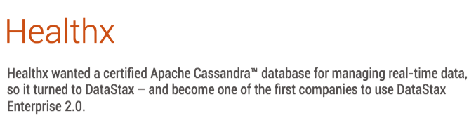
Improve the customer experience
Why DataStax?
Full-text Search… at speed and at scale
Provider Directory
“Find me a podiatrist who is female, speaks German, and is close to my home.”
HealthX

Slide 21
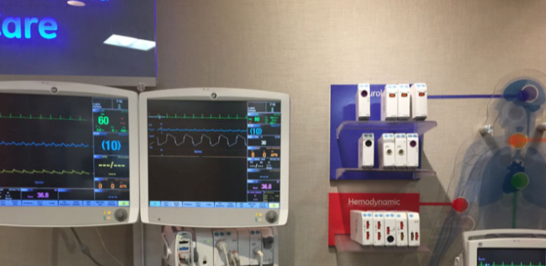
Real-time patient monitoring
Why DataStax?
High-speed, high-volume ingestion of real-time sensor data
“In a medical environment where you’re monitoring critically ill patients in real-time, a very reliable and highly available persistence layer is critical. Also minimal latencies are critical where seconds count in detecting a change in the state of a patient and alarming at the monitoring stations.”
GE Healthcare

Slide 22
Powering eCommerce for 170 million customers, one billion live listings
DataStax Enterprise with integrated search and analytics as the data platform to power eCommerce and customer experience transformation
Develop one of the world’s largest product catalogs, a catalog that is core to eBay’s mission of delivering amazing customer experiences.
Enable users to organize their search results by product instead of by listing with just one click on their mobile device.
Visual search functionality that allows users to search eBay’s inventory by taking a picture of an item they want.
eBay

Slide 23
Making sense of over 30 million data sources to provide real-time supply chain insights
Analyzing every aspect of the supply chain, and bringing new innovations to market.
Millions of suppliers, key logistics hubs, and factory data - from EDI to Twitter, and ASNs to shop floors - to identifying the patterns that are affecting supply chains.
Powered by DataStax Enterprise Graph, contextualizing massive amounts of real-time information with multi-tiered supply chain mapping, designed to detect major external risks very quickly.
Elementum

Slide 24
Why Cassandra?
Notes:
Time now to begin talking about technology. Let’s begin with Cassandra itself, and take a look at what it is, and why it matters.

Slide 25
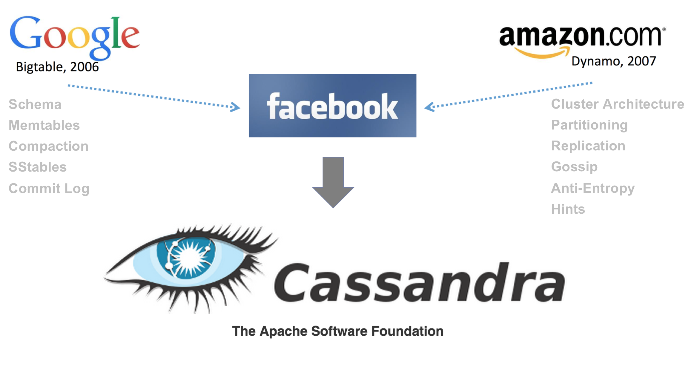

Cassandra Roots
The Apache Cassandra Experts
Notes:
Cassandra began life as a project within Facebook. Engineers there took key NoSQL wide-row concepts from Google BigTable, as well as important Clustering concepts from Amazon Dynamo. We’ll be diving deeper into these concepts in the hands-on sessions. In 2008, Facebook donated its work to the Apache Foundation, and Cassandra was born.
<CLICK> In 2010, DataStax was founded. But what was the problem we were all setting out to solve? Why did the world need Cassandra?

Slide 26
Relational Model
MFR
MFR_PK
ADDRESS
CONTACT_NAME
CONTACT_PHONE
COMMENTS
PART
PART_PK
SPECS
COMMENTS
BIN
BIN_PK
PART_FK
MFR_FK
SHIPPER_FK
DATE_RECVD
QUANTITY_ORIG
QUANTITY_LEFT
UNUSABLE_PCT
PRICE
COMMENTS
SHIPPER
SHIPPER_PK
ADDRESS
CONTACT_NAME
CONTACT_PHONE
COMMENTS
Notes:
To answer that question, let’s look at the alternative at that time… relational databases. Here is a simplistic schema that represents the warehouse of a manufacturing firm.
<CLICK> PARTS are the types of items a fabricator uses. For example, a 2-inch bolt might be a part.
<CLICK> BINs represent specific BATCHES of a part… from a specific supplier and shipped by a specific shipper.
<CLICK> We can also tie each item back to its Manufacturer, and see how to contact the firm if we have any issues.
<CLICK> Similarly, we can tie each item back to the SHIPPER who delivered it. Again, we can see how to contact the Shipper if there are any issues.

Slide 27
Update Planes, Query Vectors
BIN
BIN_PK
PART_FK
MFR_FK
SHIPPER_FK
DATE_RECVD
QUANTITY_ORIG
QUANTITY_LEFT
UNUSABLE_PCT
PRICE
COMMENTS
Updates are “flat” and independent…
MFR
MFR_PK
ADDRESS
CONTACT_NAME
CONTACT_PHONE
COMMENTS
SHIPPER
SHIPPER_PK
ADDRESS
CONTACT_NAME
CONTACT_PHONE
COMMENTS
PART
PART_PK
SPECS
COMMENTS
Notes:
I’d like to examine this type of structure using a Geometry analogy, because that will help us compare it with Cassandra concepts. Consider each of those relational tables as what I’ll call “update planes.” They are flat and independent of each other. For example, if a Manufacturer changes its Contact Name, we can simply update that table. There is no impact on any of the other tables.

Slide 28

Update Planes, Query Vectors
BIN
BIN_PK
PART_FK
MFR_FK
SHIPPER_FK
DATE_RECVD
QUANTITY_ORIG
QUANTITY_LEFT
UNUSABLE_PCT
PRICE
COMMENTS
… but Queries are a set of vectors
MFR
MFR_PK
ADDRESS
CONTACT_NAME
CONTACT_PHONE
COMMENTS
Fabricator
SHIPPER
SHIPPER_PK
ADDRESS
CONTACT_NAME
CONTACT_PHONE
COMMENTS
Which bin has the highest quality for Part 403?
PART
PART_PK
SPECS
COMMENTS
Notes:
Queries, though, are a very different story. Since we must Join data, I’ve imagined this as a set of Vectors we use to navigate from plane to plane. In this example, a Fabricator wants to get parts from the bin which has the lowest number in the Bin’s UNUSABLE_PERCENTAGE column. To make this query, the Fabricator looks up the Part to get its Part number, which enables a search for the best BIN.

Slide 29
Update Planes, Query Vectors
BIN
BIN_PK
PART_FK
MFR_FK
SHIPPER_FK
DATE_RECVD
QUANTITY_ORIG
QUANTITY_LEFT
UNUSABLE_PCT
PRICE
COMMENTS
… but Queries are a set of vectors
MFR
MFR_PK
ADDRESS
CONTACT_NAME
CONTACT_PHONE
COMMENTS
Purchasing
SHIPPER
SHIPPER_PK
ADDRESS
CONTACT_NAME
CONTACT_PHONE
COMMENTS
Which Manufacturer/Shipper combination has the lowest recent price for Part 403?
PART
PART_PK
SPECS
COMMENTS
Notes:
Here’s another example. A Purchasing agent needs to find the Manufacturer/Shipper combination that has recently provided the lowest total price for a Part. The Purchaser looks up the Part Number, which leads to the BINs, which lead to detailed information on the Manufacturer and Shipper.

Slide 30
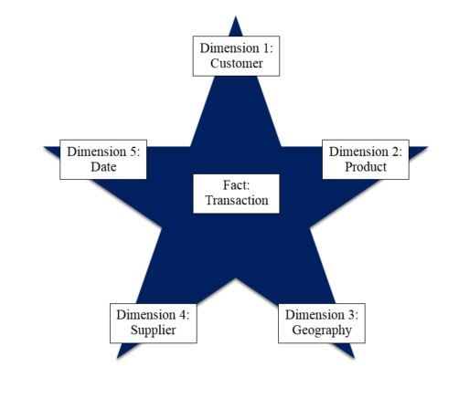
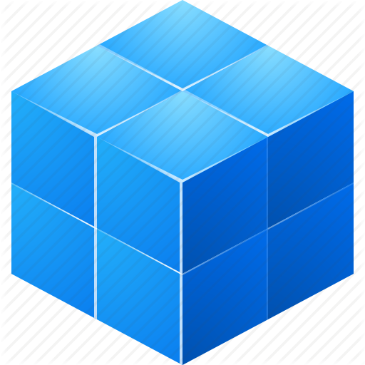

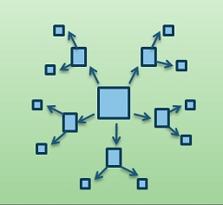
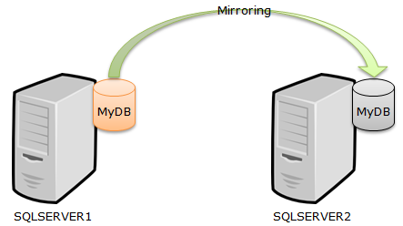
… but is that a bad thing?
No, until we scale… (think internet, mobile, big data, digital transformation, etc.)
High data volume
High query load
High volatility
But then came the tipping point…
Notes:
This is all very standard procedure for relational databases. So, is that a bad thing?
<CLICK> No, not at all… until we start scaling our database to very high data volumes, with high query loads, and high update volatility. At scale, we begin to face issues with the relational model.
<CLICK> Actually, we’ve been seeing these issues for decades. First we started creating mirror databases, so complex queries would not impact day-to-day transactional processing.
<CLICK> Then those queries on the mirror started becoming too slow, so we began de-normalizing into Star Schemas.
<CLICK> Star Schemas morphed into Snowflakes…
<CLICK> … and then into Cubes…
<CLICK> … but we really didn’t notice the growing problem, because it happened gradually. We were like the proverbial frog in the pot of water on the stove.
<CLICK> But then came an architecture innovation that caused a tipping point in our perception of databases.

Slide 31

Clusters force the issue
Clusters are the new frontier for modern scalability…
… but node locality is not feasible in a join-centric design.
Notes:
<CLICK> As databases became larger and larger, and as client connections became more and more geographically dispersed, and as continuous availability became more and more essential, we began to realize that the future of data storage would involve clusters of commodity hardware.
<CLICK> When a database is spread across a cluster, query performance demands that we retrieve data from as few nodes as possible. Node locality of data for each specific query is of paramount importance. Joins, then, the very heart of the relational model for queries, become highly problematic. It now became apparent that a new approach was needed.

Slide 32
From Update Planes, Query Vectors, to…
BIN
BIN_PK
PART_FK
MFR_FK
SHIPPER_FK
DATE_RECVD
QUANTITY_ORIG
QUANTITY_LEFT
UNUSABLE_PCT
PRICE
COMMENTS
MFR
MFR_PK
ADDRESS
CONTACT_NAME
CONTACT_PHONE
COMMENTS
SHIPPER
SHIPPER_PK
ADDRESS
CONTACT_NAME
CONTACT_PHONE
COMMENTS
PART
PART_PK
SPECS
COMMENTS
Purchasing
Notes:
Cassandra addressed that issue head-on. Instead of the Relational model of Update Planes and Query Vectors…

Slide 33
Query Planes, Update Vectors
PART_BY_QUALITY
PART_ID
BIN_ID
UNUSABLE_PCT (ASC)
PART_DESCRIPTION
QUANTITY_LEFT
MANUFACTURER
SHIPPER
COMMENTS
PART_BY_PRICE
PART_ID
PRICE (ASC)
MANUFACTURER
SHIPPER
PART_DESCRIPTION
COMMENTS
Notes:
Cassandra flips the paradigm: Query Planes, and Update Vectors. Instead of modeling for flat updates, we model for flat queries. Here are two tables modeled as Query Planes.

Slide 34
Query Planes, Update Vectors
PART_BY_QUALITY
PART_ID
BIN_ID
UNUSABLE_PCT (ASC)
PART_DESCRIPTION
QUANTITY_LEFT
MANUFACTURER
SHIPPER
COMMENTS
PART_BY_PRICE
PART_ID
PRICE (ASC)
MANUFACTURER
SHIPPER
PART_DESCRIPTION
COMMENTS
Notes:
The high-order portions of their keys can be hashed, and the resulting hash can point directly to a node that contains the specific data for the key.

Slide 35
Query Planes, Update Vectors
PART_BY_QUALITY
PART_ID
BIN_ID
UNUSABLE_PCT (ASC)
PART_DESCRIPTION
QUANTITY_LEFT
MANUFACTURER
SHIPPER
COMMENTS
PART_BY_PRICE
PART_ID
PRICE (ASC)
MANUFACTURER
SHIPPER
PART_DESCRIPTION
COMMENTS
Notes:
The low-order parts of the key can represent a sort order for individual records that share the high-order part of the key.

Slide 36
Query Planes, Update Vectors
PART_BY_QUALITY
PART_ID
BIN_ID
UNUSABLE_PCT (ASC)
PART_DESCRIPTION
QUANTITY_LEFT
MANUFACTURER
SHIPPER
COMMENTS
PART_BY_PRICE
PART_ID
PRICE (ASC)
MANUFACTURER
SHIPPER
PART_DESCRIPTION
COMMENTS
Notes:
Note that many of the columns are actually duplicated in these two tables. We are modeling for query performance, and we achieve this performance by minimizing the number of access points we need at query time.

Slide 37
Query Planes, Update Vectors
PART_BY_QUALITY
PART_ID
BIN_ID
UNUSABLE_PCT (ASC)
PART_DESCRIPTION
QUANTITY_LEFT
MANUFACTURER
SHIPPER
COMMENTS
Fabricator
PART_BY_PRICE
PART_ID
PRICE (ASC)
MANUFACTURER
SHIPPER
PART_DESCRIPTION
COMMENTS
Purchasing
Notes:
Our Vectoring, then, happens at Update time, not at Query time. Cassandra is designed to support this model. In Cassandra, reads are very fast, but writes are insanely fast. Especially note that multiple writes can be done asynchronously. That isn’t possible with reads in a relational world, because you have to read the driver table before you can read the driven table.

Slide 38
Advantage: Cassandra
Horizontal Scalability
Continuous Availability
Geographic Distribution
Node data locality
Notes:
By flipping the relational model on its head, Cassandra provides a design that it perfectly suited for cluster-resident databases. We can now take advantage of the power of clustering: linear horizontal scalability, unparalleled fault tolerance, and geographic distribution. This is all possible because Cassandra helps us satisfy individual queries on as few nodes as possible.

Slide 39
Why DataStax Enterprise?
Notes:
We have seen why the world needs Cassandra… but why does the world need the DataStax Enterprise platform? Let’s take a look.

Slide 40

Enterprise Data Layer?
Cassandra++
Usability
Manageability
Security
Support
The Last Mile
Flexible Search
Analytics
Graph
Notes:
As great as Cassandra is, it does not take us all the way to a comprehensive data layer for the modern enterprise. DataStax Enterprise fills that gap in two important ways.
<CLICK> First, DataStax makes Cassandra a better, more enterprise-worthy product, by providing a number of enhancements in areas like usability, manageability, security, and support.
<CLICK> Second, DataStax integrates other capabilities that are missing in Cassandra, but are required for a complete enterprise data layer. These include Search, Analytics and Graph. Over the course of today’s session, you’ll get hands-on with all of these topics, but I’ll give a brief introduction to get us started.

Slide 41
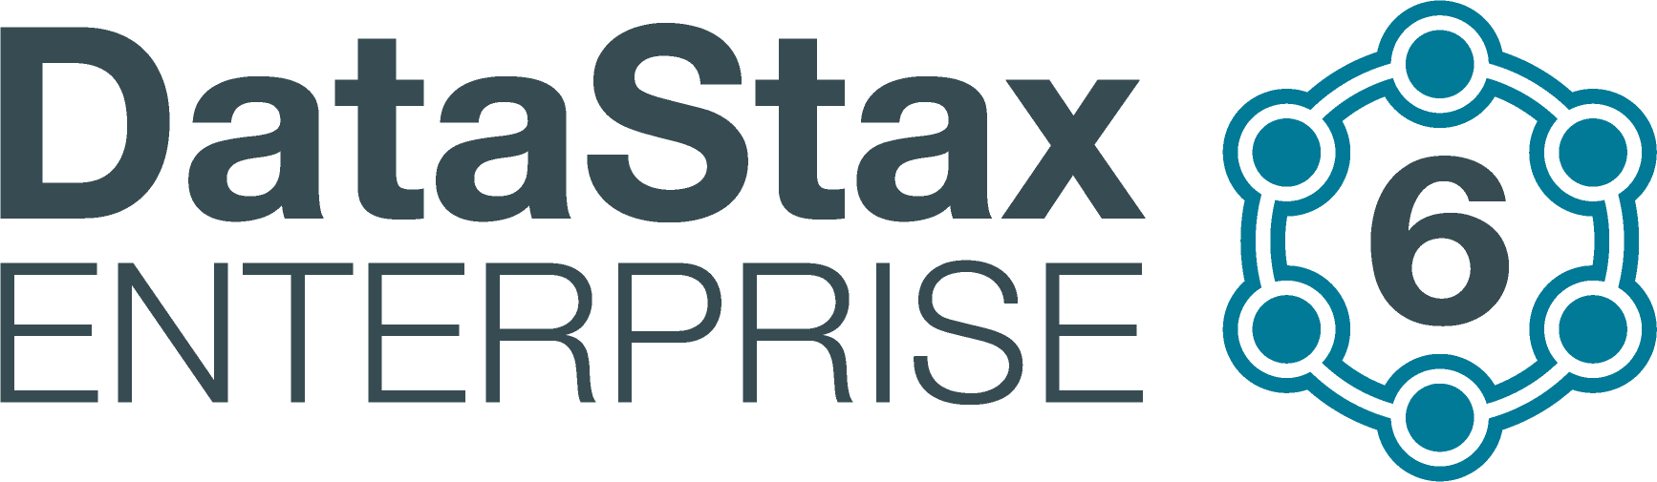
Cassandra++
Superior performance (2x-3x faster)
Superior System Administration: OpsCenter, Repair, Bulk Load, Upgrades, etc.
Enterprise-grade security
Graphical Development Studio
24x7x365 Follow-the-Sun Support
Notes:
First, let’s consider the improvements DataStax offers to Cassandra itself. DSE Cassandra is 2 to 3 times faster than open-source Cassandra. It provides superior system administration capabilities, including a graphical Operations Center, and greatly improved administration utilities for automatic node repair, bulk loading, version upgrades, and so on. It provides Enterprise-grade security that is lacking in open-source Cassandra. DSE includes a graphical development studio.
<CLICK> Most important of all, DataStax offers world-class support, which of course is a key requirement for any large enterprise.

Slide 42




Cassandra++: Security
EXTERNAL AUTHENTICATION
TRANSPARENT DATA ENCRYPTION
DATA AUDITING
ROW-LEVEL ACCESS CONTROL
SECURED ADMIN
External validation of authorized users
Leverages Kerberos & LDAP/AD
Single sign-on to all data domains
Protects sensitive customer data at rest via encryption
No need to change application
Audit trail of all access and changes
Audit only what’s needed
Flexible logging with log4j interface
Protect your sensitive data with granular security
Simplify management for multi-tenancy deployments
Protects against unauthorized viewing of schema
Administrative access without data access
Notes:
Let’s take a moment to look at the details of our Security enhancements. DSE ensures that your sensitive information is always protected and stringent compliance requirements are always met. Almost all large enterprises require their data layer to integrate with external authentication systems, such as Active Directory, other LDAP products, and/or Kerberos. Encryption of data at rest is becoming a common enterprise requirement. Comprehensive access and change auditing is a must. Row-level data access control is essential for large enterprises with many different categories of users, or for enterprises with multi-tenancy needs. And in a large enterprise, System Administration is a team sport, requiring highly granular access levels for different types of administrators. DataStax enterprise supports all these security needs.

Slide 43









Are we there yet?
Your Datacenter
Contextual
Always-On
Real-Time
Distributed
Scalable
Notes:
At the beginning of this presentation, I listed a set of key requirements for a comprehensive enterprise data layer. Let’s see if we have met them yet.
<CLICK> Yes, DSE offers virtually unlimited linear scalability.
<CLICK> Clusters can be geographically dispersed across many physical data centers.
<CLICK> As we have seen, DSE is optimized for extremely fast real-time responses.
<CLICK> Our masterless, active-everywhere, shared-nothing architecture ensures that a properly-distributed cluster can provide continuous availability.
<CLICK> DSE is well suited for deployment in and across clouds…
<CLICK> … on-premise, or in hybrid-cloud mode.
<CLICK> However, there is still one high-level requirement we need to fulfill. A large, complex enterprise has a diverse user community that needs to see and manipulate data in many different contexts. Let’s examine these data contexts in the enterprise, and see how DSE meets their needs.

Slide 44

Contextual Dimensions
Operational Data Store
Flexible Search
Analytics
Graph
Notes:
As we have seen, Core Cassandra clearly satisfies the context where users need to make fast pinpoint queries to support day-to-day operations.
<CLICK> Let’s examine a new context: users who need a very flexible Search capability.

Slide 45
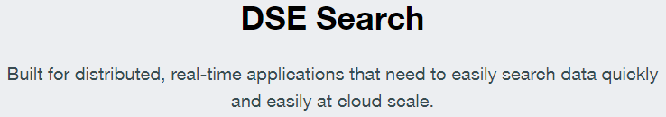
Flexible Search
Oxidation
Rusted
Rusty
Corrosion
Rusting
PART_BY_QUALITY
PART_ID
BIN_ID
UNUSABLE_PCT (ASC)
PART_DESCRIPTION
QUANTITY_LEFT
MANUFACTURER
SHIPPER
COMMENTS
Fabricator
Notes:
This Fabricator has a special concern. He is building a product that will be used in wet conditions…
<CLICK> … and he needs to choose parts that won’t rust.
<CLICK> He knows that other Fabricators might have entered free-form text comments that might help him, but he needs a way to search that text.
<CLICK> Since the text is free-form, he also wants other word forms to be returned, like Rusty…
<CLICK> … or Rusted.
<CLICK> And he also needs synonyms to be returned automatically, like Corrosion…
<CLICK> … or Oxidation. Core Cassandra is not built to handle these situations.
<CLICK> To fill that gap, DSE provides a Search capability, which is seamlessly integrated with Cassandra’s query facility. You’ll work with this yourselves in the hands-on session coming up soon.

Slide 46
Contextual Dimensions
Operational Data Store
Flexible Search
Analytics
Graph
Notes:
We’re getting closer to that comprehensive enterprise data layer.
<CLICK> Next let’s consider the Analytics data context.

Slide 47
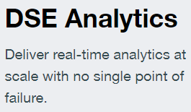
Analytics
PART_BY_QUALITY
PART_ID
BIN_ID
UNUSABLE_PCT (ASC)
PART_DESCRIPTION
QUANTITY_LEFT
MANUFACTURER
SHIPPER
COMMENTS
For every Part, which Mfr/Shipper combinations give me the best quality for the price?
PART_BY_PRICE
PART_ID
PRICE (ASC)
MANUFACTURER
SHIPPER
PART_DESCRIPTION
COMMENTS
Business Analyst
Notes:
Core Cassandra excels at answering day-to-day operational queries, but Business Analysts and Data Scientists need answers to ad hoc, unforeseen questions.
This Analyst needs to produce a large result set showing which Supplier/Shipper combinations provide the best quality/price ratio for EVERY part.
<CLICK> DSE Analytics enhances Core Cassandra by providing this Analytics capability. Again, you’ll be hands-on with it soon.

Slide 48
Contextual Dimensions
Operational Data Store
Flexible Search
Analytics
Graph
Notes:
We’ve almost reached that comprehensive data layer.
<CLICK> Let’s examine one more context: Graph.

Slide 49

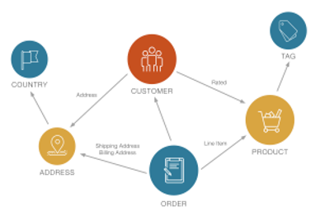
Graph
Our best customer is reporting inconsistent quality in our products. Trace the customer’s low-rated products through its orders to the countries that are receiving the most problematic deliveries.
Customer Support
Notes:
This customer support specialist has a very complex problem. Our best customer, a world-wide distributor, is hearing complaints about some of our products from its various warehouses. The customer has very few details. We don’t know if it’s a problem in Fabrication, or if we’re getting poor quality items from some of our Manufacturers, or if certain of our Shippers are damaging goods in transit. We need to find out which countries’ warehouses are reporting which problems with which aspects of which products.
<CLICK> The best way to follow a complex path like this is to use a Graph database. DSE provides a Graph Database capability that uses Cassandra for underlying data storage. And of course, you’ll be touching it yourself in an upcoming session.

Slide 50
Contextual Dimensions
Operational Data Store
Flexible Search
Analytics
Graph
Notes:
DataStax Enterprise adds capabilities to Cassandra that enable the platform to serve all the data usage contexts found in a large, modern enterprise.

Slide 51
Data Layer for All Stakeholders
Your Datacenter
Masterless and Active Everywhere Database
Contextual
Always-On
Real-Time
Distributed
Scalable
Notes:
Now it’s time for you to see for yourself as we begin the hands-on sessions. DataStax Enterprise is the comprehensive data layer for today’s large enterprise. It provides a data layer for your applications that is Contextual, Always-On, Real-Time, Distributed, and Scalable.

Slide 52
Use Cases

Slide 53
Use Cases… 2 main categories
Your Datacenter
Masterless and Active Everywhere Database
Contextual
Always-On
Real-Time
Distributed
Scalable
Notes:
What is of primary importance to you? Use Cases fall into two main categories of concern:
<CLICK> Life in the cloud… migrate, manage with a single pane of glass across all.
<CLICK> CARDS-based applications… let’s examine them more.

Slide 54
Great use cases
Masterless and Active Everywhere Database
Contextual
Always-On
Real-Time
Distributed
Scalable
Look for multiple stakeholders…
Customers
Partners
CSRs
BI
What is the cost of a minute of downtime?
Primary stakeholders need real-time SLA
Look for geographical distribution of clients
Look for lots of…
Data volume
Data volatility
Users
Notes:
For ROI, hit 2 or more of these.. (click through)
Not-great misses these marks. For example, data warehouse with no real-time stakeholders.

Slide 55
Learning Resources

Slide 56

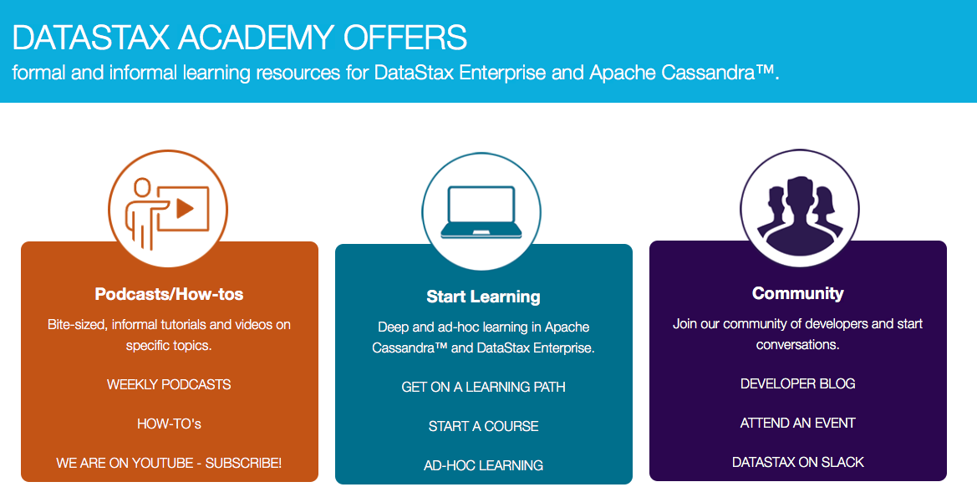
academy.datastax.com

Slide 57
Discussion and next steps

Slide 58
What can we create together?
Masterless and Active Everywhere Database
Contextual
Always-On
Real-Time
Distributed
Scalable
Look for multiple stakeholders…
Customers
Partners
CSRs
BI
What is the cost of a minute of downtime?
Primary stakeholders need real-time SLA
Look for geographical distribution of clients
Look for lots of…
Data volume
Data volatility
Users
Notes:
For ROI, hit 2 or more of these.. (click through)
Not-great misses these marks. For example, data warehouse with no real-time stakeholders.

Slide 59
Thank you!
Notes:
Thank you.

